Slide 1
Fireside Chat on Supply Chain Resilience
Dennis Lam
Alison Hung

Slide 2
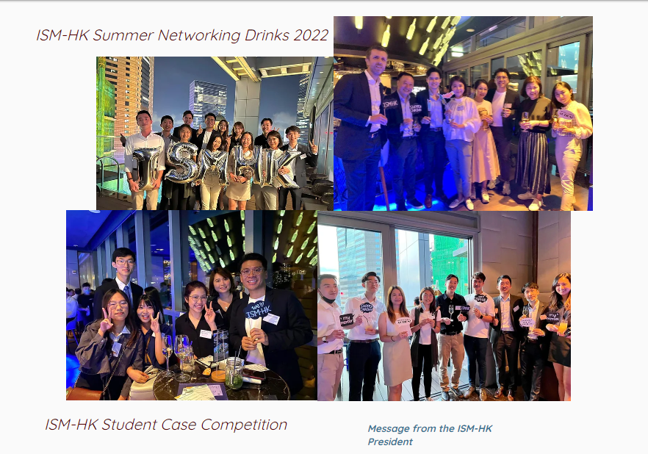
https://www.ism-hk.org/

Slide 3
Who we are?
Dennis Lam
Alison Hung

Slide 4
Agenda
Introduction
Interactive Discussion
Quick Summary

Slide 5
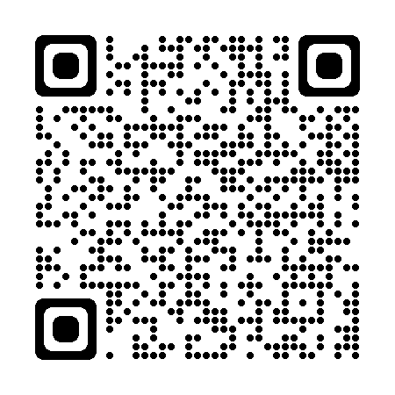
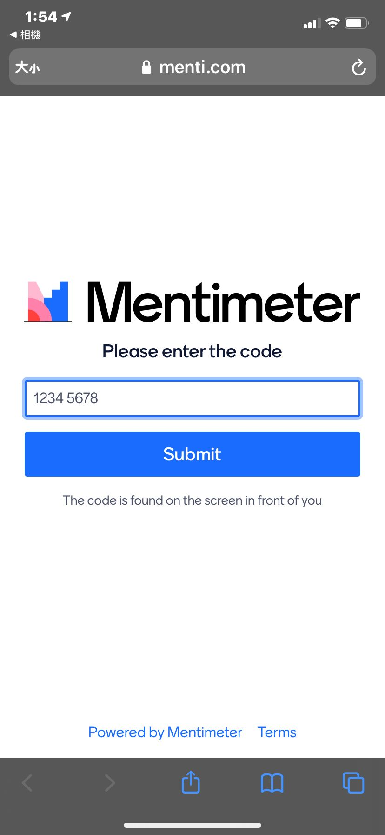
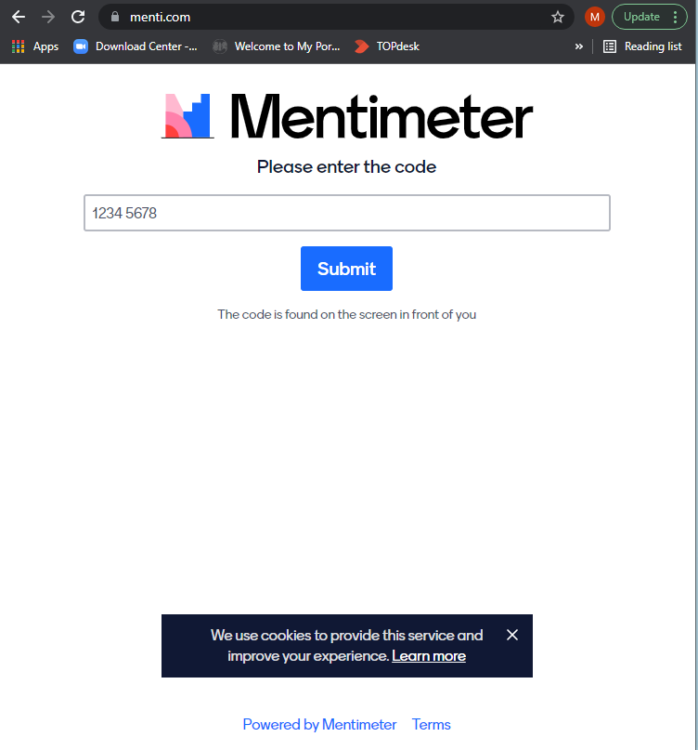
Icebreaking time via
Go to Mentimeter with the QR Code or enter the URL: www.menti.com
Enter Code 8138 6211

Slide 6
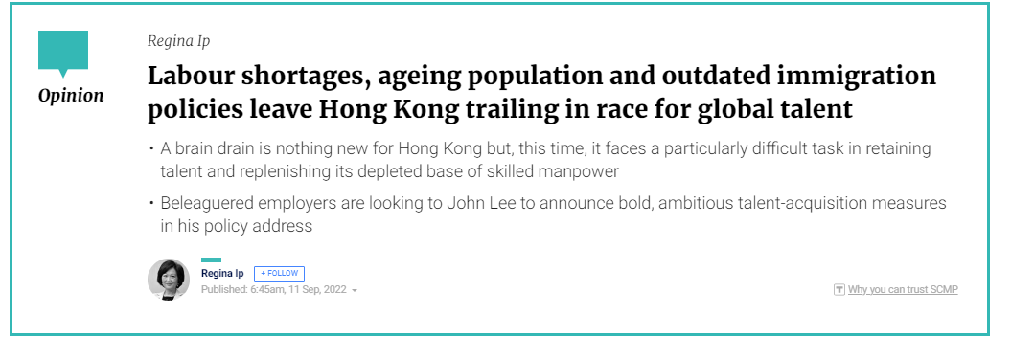
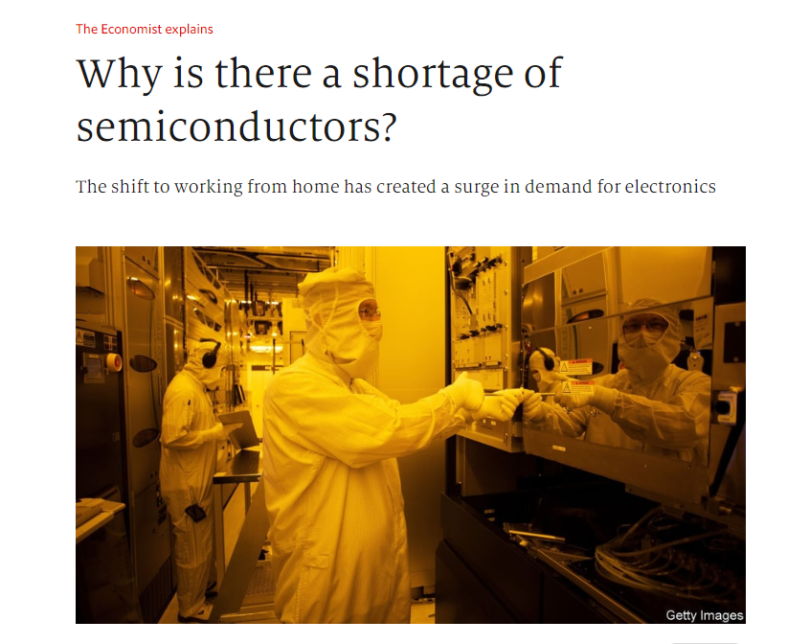
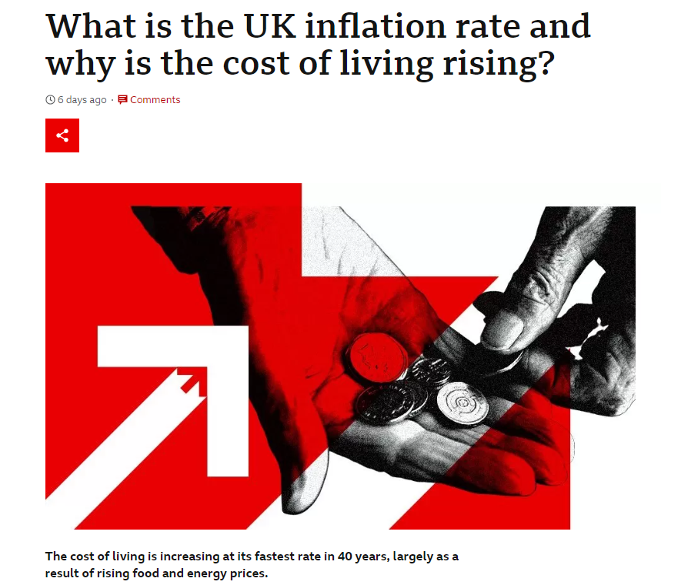
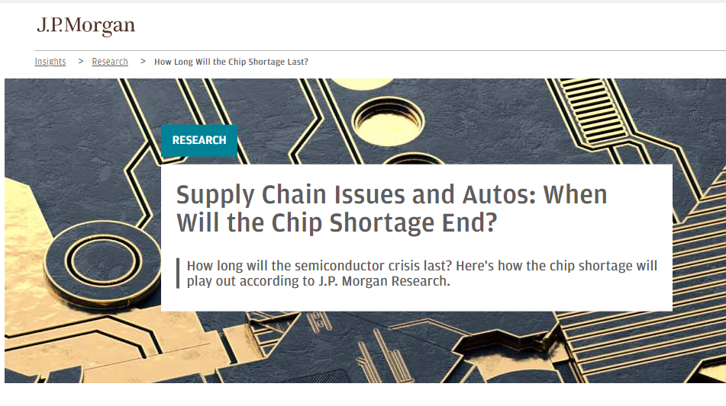
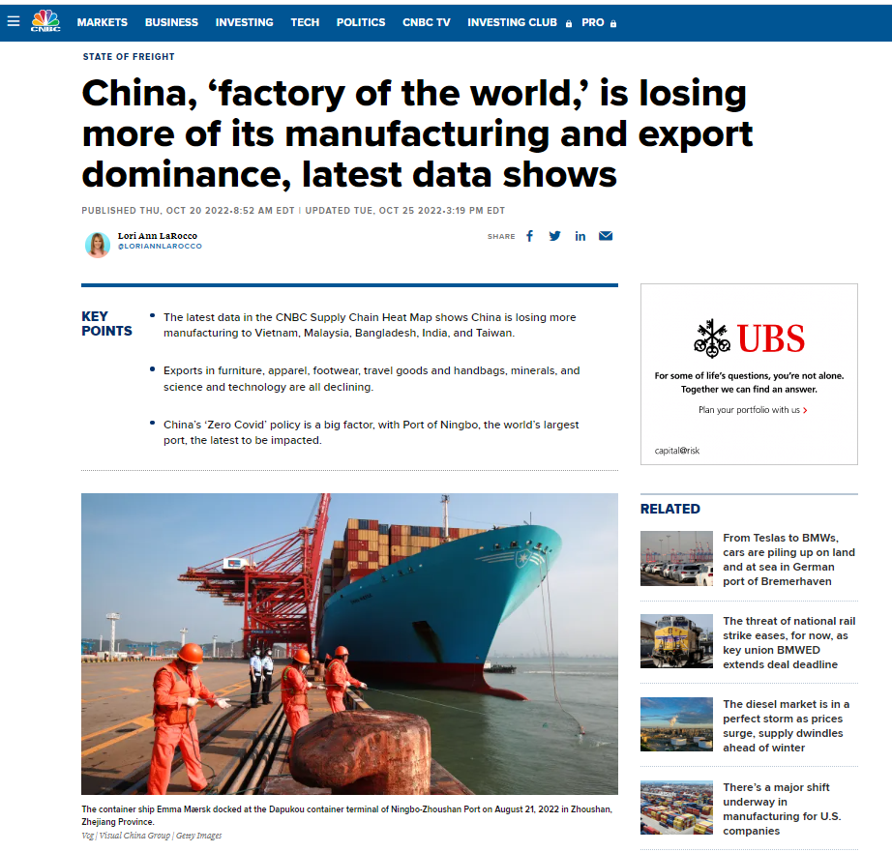
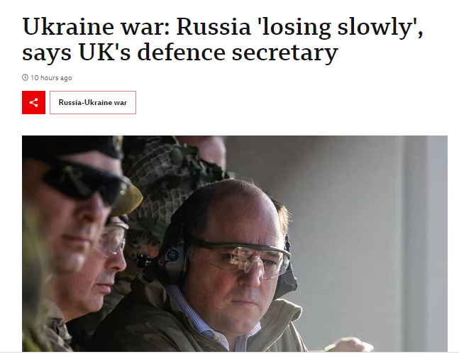
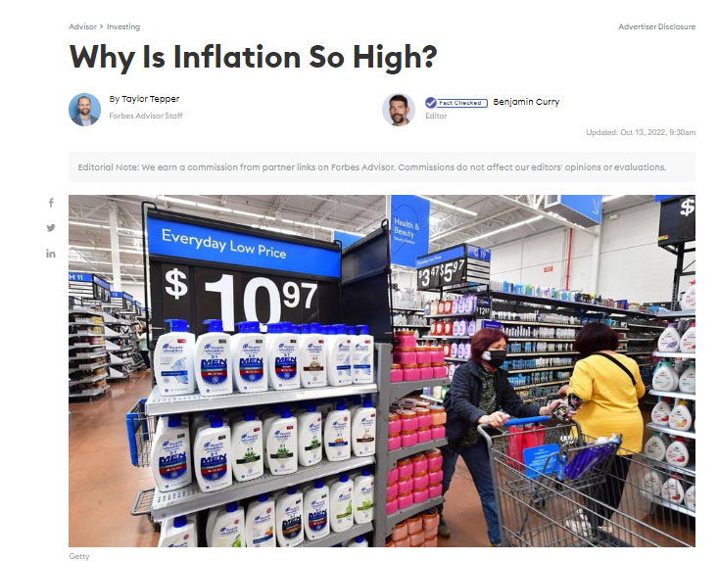
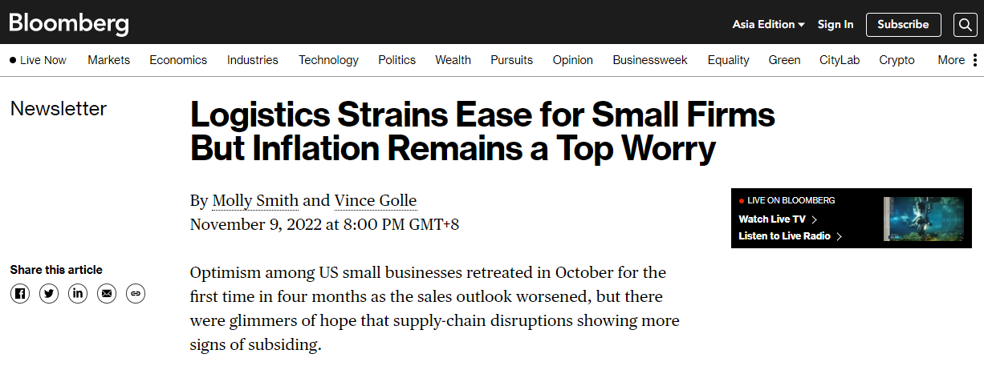
Challenges

Slide 7
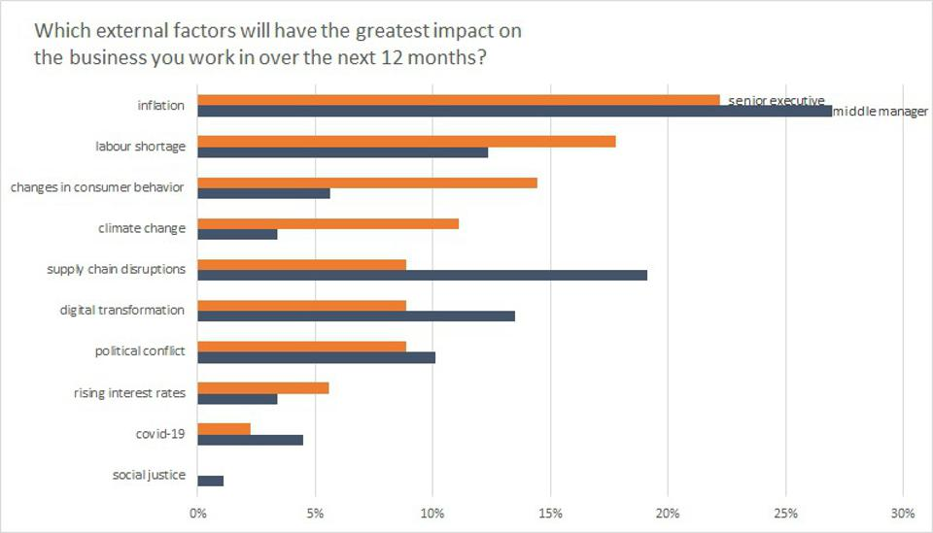
Common Challenges
Published on Forbes by Christian Stadler in Sep 2022
Factors with the greatest impact on companies
https://www.forbes.com/sites/christianstadler/2022/09/13/these-are-the-biggest-challenges-facing-companies-right-now-exclusive-survey-of-c-suite-and-middle-managers/?sh=5a74e26016cc

Slide 8
Inflation
Supply Risk
ESG
Digitalization

Slide 9
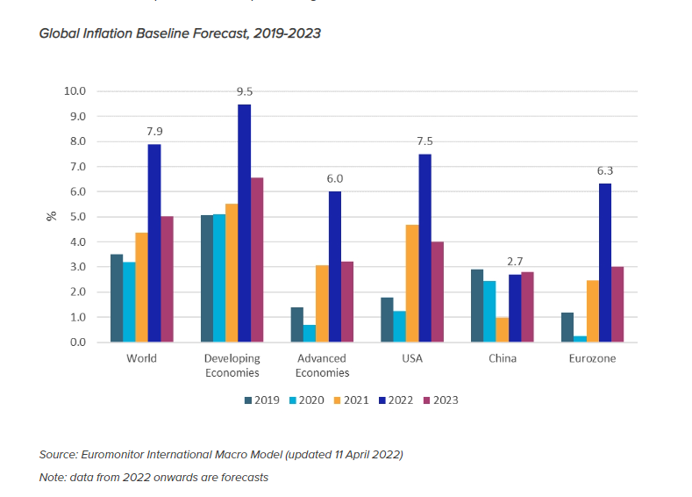
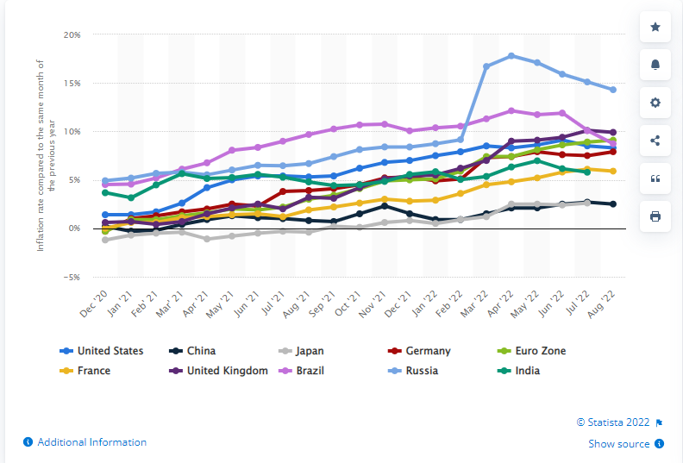
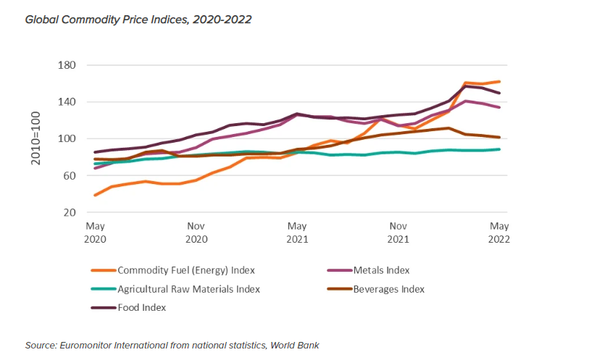
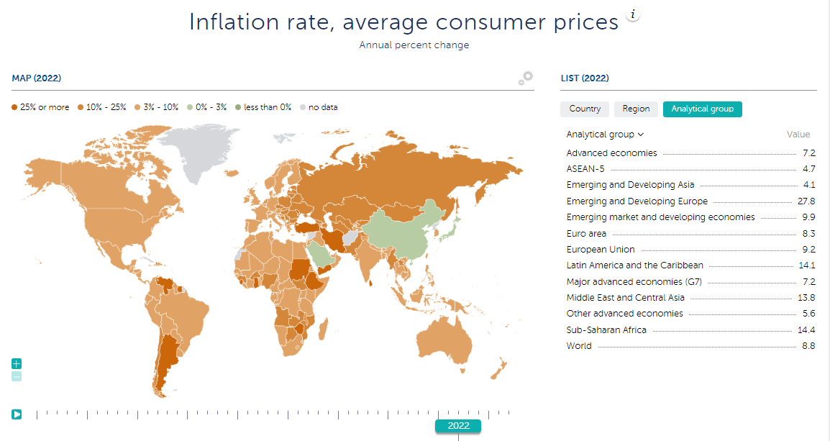
Inflation
https://www.statista.com/statistics/1034154/monthly-inflation-rates-developed-emerging-countries/

Slide 10
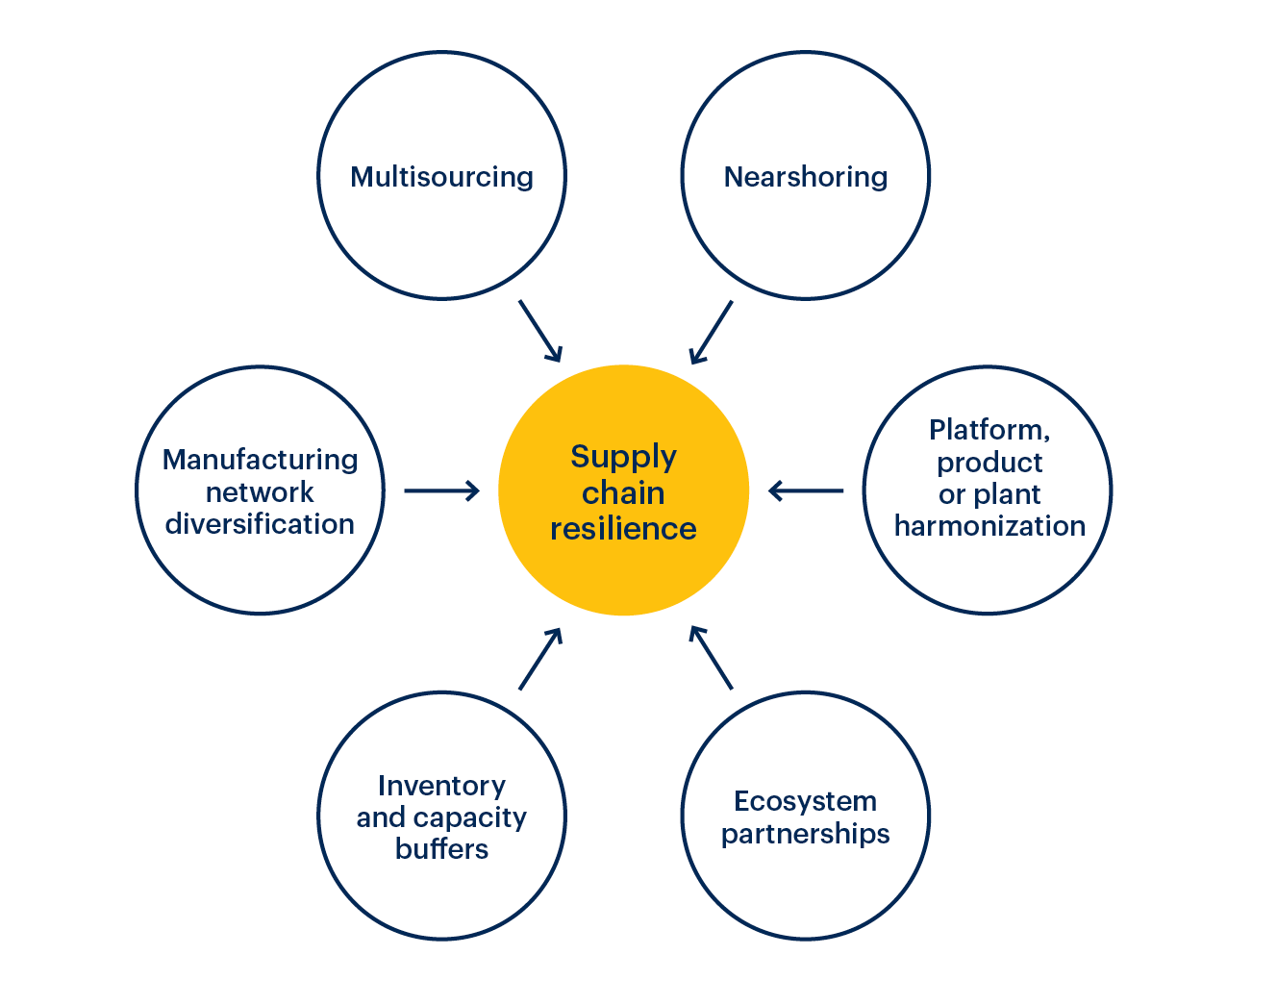
Risk Mitigation
2
3
1
4
6
5
https://www.gartner.com/smarterwithgartner/6-strategies-for-a-more-resilient-supply-chain

Slide 11
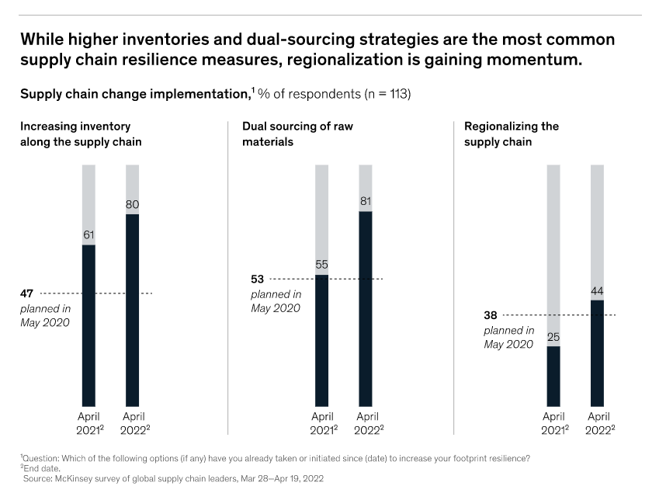
Dual Sourcing

Slide 12
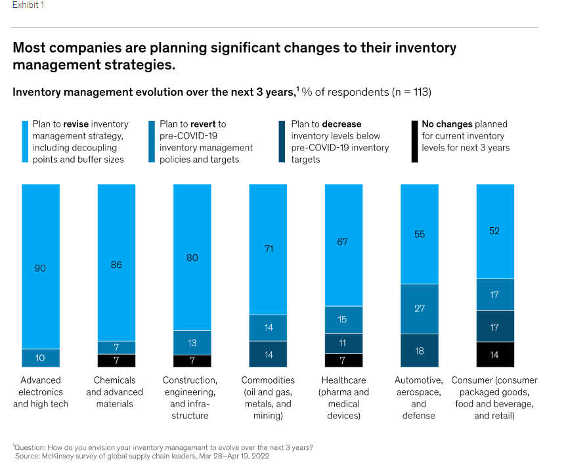
Network resilience

Slide 13
ESG for Procurement
17 Sustainable development goals of United Nations

Slide 14
ESG for Procurement
17 Sustainable development goals of United Nations
14

Slide 15
Digitalization
Artificial intelligence (AI)
Facial recognition
Blockchain
RFID
GPS tracking
Chatbots
Voice recognition
Virtual reality (VR) / Augmented reality (AR)
Robotics / Automation
Barcodes / QR codes
Data analytics
Internet of things (IoT)/ sensory devices
Cloud computing
5G connection

Slide 16
Tips for Improvement
Redesigning the global network
Setting new parameters of supply chain buffers
Proactively managing suppliers
Managing the Multi-enterprise Supply Chain
Actively Managing End-to-End Risk
Planning Based on Anticipation, Simulation, and Scenarios
Make Data-Driven Decision
Manage the Expectations of Your Customer
https://www.bcg.com/publications/2021/building-resilience-strategies-to-improve-supply-chain-resilience

Slide 17
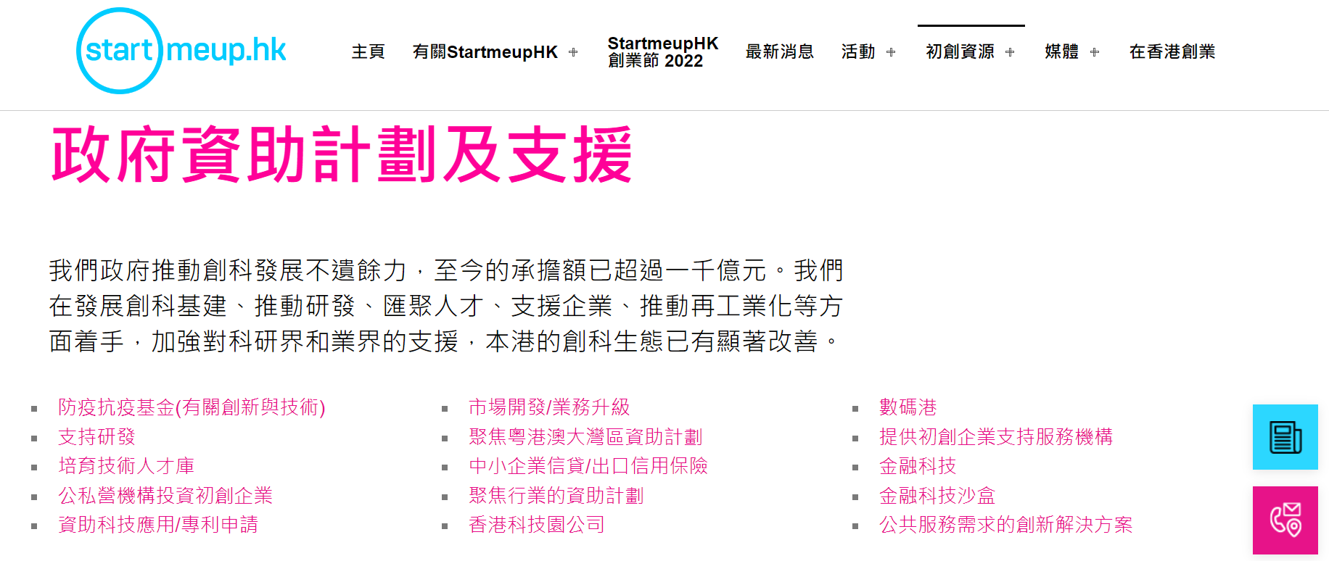
Resources for SME
https://www.startmeup.hk/zh-hant/startup-resources/government-funding-scheme-and-support/
https://www.ofca.gov.hk/tc/industry_focus/industry_focus/5g_subsidy/index.html
https://www.smefund.tid.gov.hk/tc_chi/emf/emf_update.html
https://www.itc.gov.hk/ch/fund_app/dlri/apply.html

Slide 18
THANK YOU
Please join ISM-HK!

